Slide 1
Examining Chicago’s Murder Rate
BY DANIEL PELLEGRINI

Slide 2
Hypothesis and General Knowledge
This project looks at Chicago’s murder rate from an overall perspective. It examines numerous things that can affect Chicago’s homicide rate.
All of these factors will help to answer my hypothesis: Chicago’s murder rate has gone down from 2001 to 2019
The location where murders occur
At what time of day murders occur
What day of the week murders occur
Some background information regarding this presentation.
Website: https://data.cityofchicago.org/Public-Safety/Crimes-2001-to-present/ijzp-q8t2
Specific locations where homicides occur are not given; location is given at the block level
Chicago is divided into three districts: North, Central, and South
Time period: 2001 to 2019

Slide 3
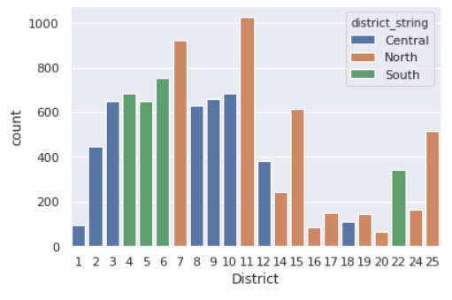
Where Chicago’s Murders Occur
Key Observations
There are 22 districts total
North has 10 districts
Central has 8 districts
South has 4 districts
North has the 2 highest while having 5 of the 7 lowest murder rate districts
South has 3 of the top 9 districts with the highest murder rates

Slide 4
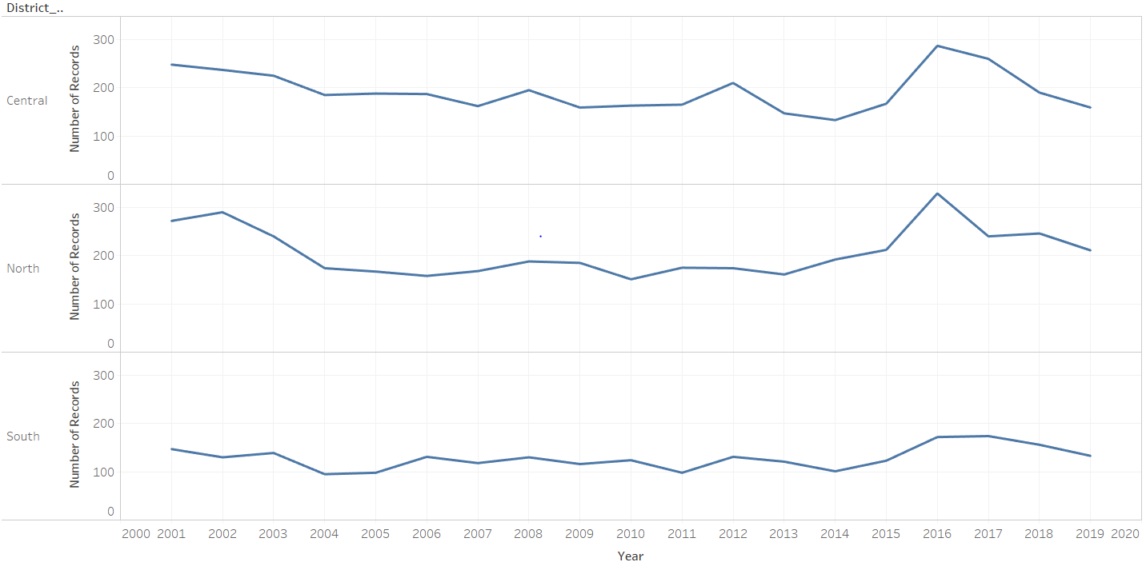
Murders by Time and Location
North, South and Central districts had a slight downtick in number of murders from 2001 to 2019
2016 was the high point in all 3 districts for most number of murders
Since 2016 the number of murders has trended downward

Slide 5
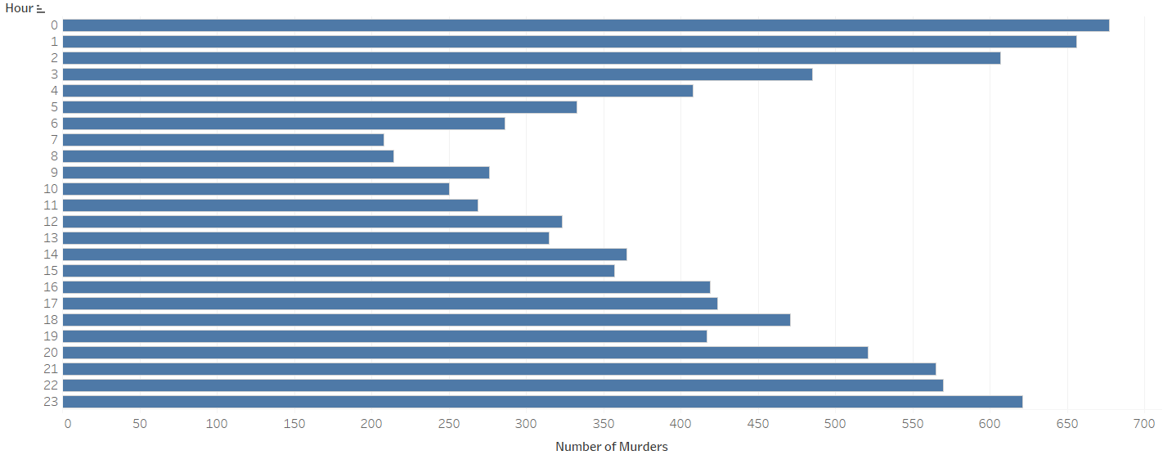
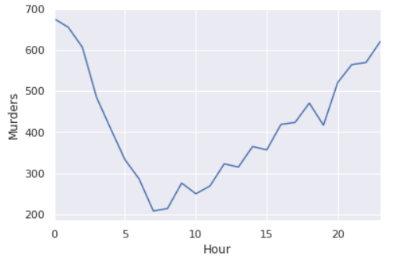
The Time of Day When Murders Occur
0 corresponds to 12:00 am, 1 corresponds to 1:00 am, and so on
12 corresponds to 12:00 pm, 13:00 corresponds to 1:00 pm, and so on
Most murders occur early in the morning or late at night
7:00 am and 8:00 am have the least number of murders

Slide 6
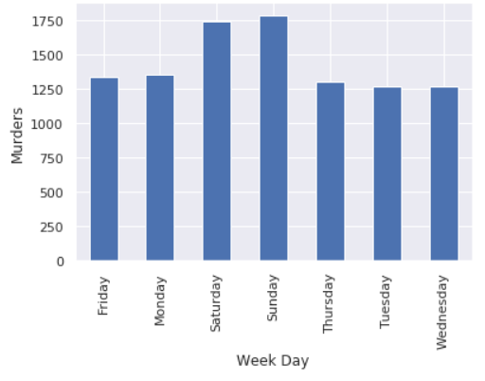
Week Days When Murders Most Often Occur
Key Observations:
Saturday and Sunday have the highest number of murders
The middle parts of the week (Tuesday, Wednesday, Thursday) have the fewest number of murders

Slide 7
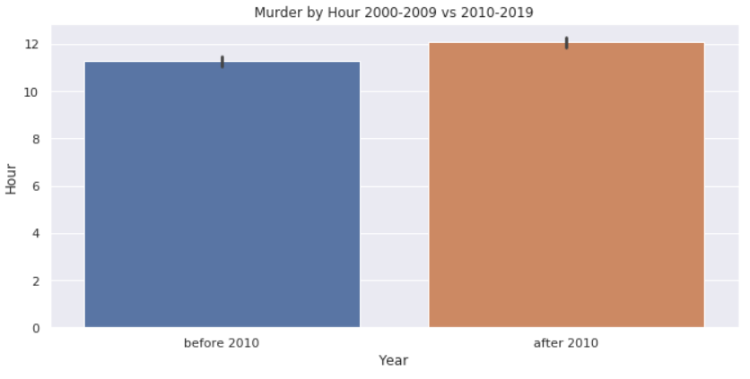
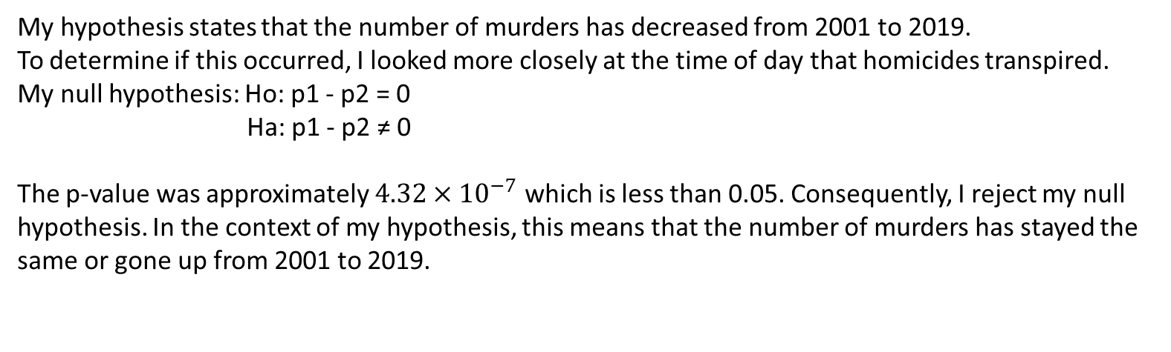
Statistical Work
My hypothesis states that the number of murders has decreased from 2001 to 2019.
To determine if this occurred, I looked more closely at the time of day that homicides transpired.
My null hypothesis: Ho: p1 - p2 = 0
Ha: p1 - p2 ≠ 0
The p-value was approximately $4.32×{10}^{−7}$ which is less than 0.05. Consequently, I reject my null hypothesis. In the context of my hypothesis, this means that the number of murders has stayed the same or gone up from 2001 to 2019.
To verify my data, I used confidence intervals and looked for an overlap between them.
Since there is no overlap between confidence intervals before 2010 and after 2010, I reject my null hypothesis.

Slide 8
Conclusion
There are numerous factors that can affect a city’s murder rate.
Recommendation: Chicago has seen an uptick in murders from 2001 to 2019. Specifically, the number of homicides has peaked in 2016 and gone down from there.
In the future, Chicago needs to put more police on the streets at night and on weekends. This is when a good portion of the homicides in Chicago occur. Moreover, Chicago needs to invest in neighborhood development in certain areas of the city. The ‘South’ area of Chicago only consists of 4 districts. However, 3 of those 4 districts are among the top 9 districts in this city regarding homicides.
The location where murders occur
At what time of day murders occur
What day of the week murders occur

